Slide 1

Trust in Human–AI Interaction
Presented by:
Group-03 (PSY101, Section-14)
Humayra Adiba
ID- 23201401
Samaila Islam Ocean
ID- 22236076
Tasnim Rahman Moumita
ID- 22301689
Kazi Fouzia
ID- 23117006

Slide 2





“We don’t just use AI — we decide whether to trust it.”
Research Question: How Individuals percieve and trust AI in daily life?
Method: Student Survey
Source: Based on Arxiv Research
Tool: 5-point Likert Scale (Reliability, Integrity, Security, Harmfulness, Trust)

Slide 3
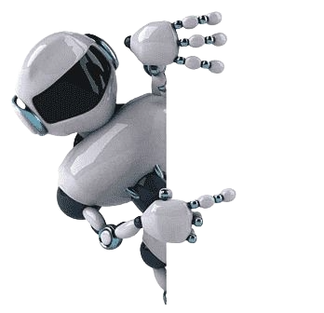
Why Study Trust in AI?
Balanced Trust⚖️
Careful use of AI = safer outcomes
Improves decisions & efficiency
Human + AI collaboration
Over-Trust⚠️
Blindly relying on AI → bias, errors
Misinformation risk
Loss of critical thinking
Under-Trust 🚫
Ignoring AI’s potential
Missed innovation
Wasted efficiency

Slide 4
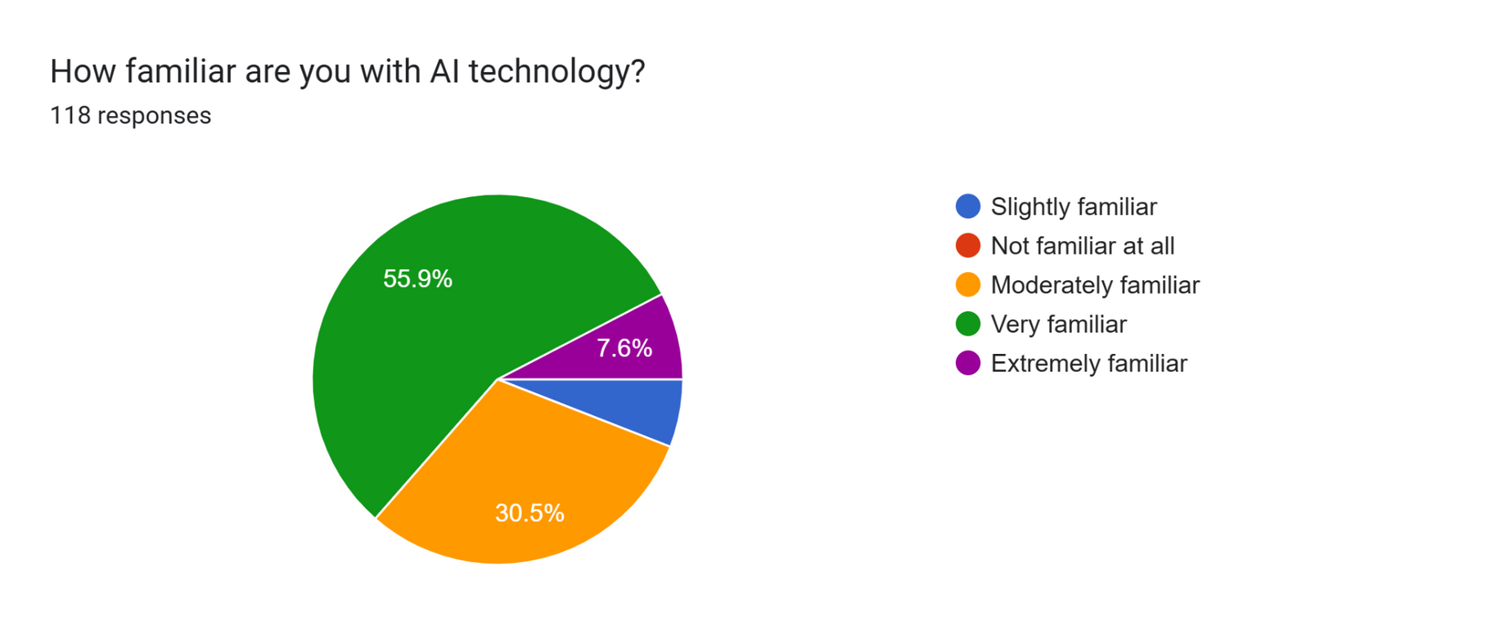
Survey Details
Conducted on university students (19–26 years old)
Majority from the Biotechnology and Computer Science fields
Used an online form with scale-based and open-ended questions
To capture student perspectives on AI familiarity, trust, and risks
Figure: Familiarity with AI

Slide 5
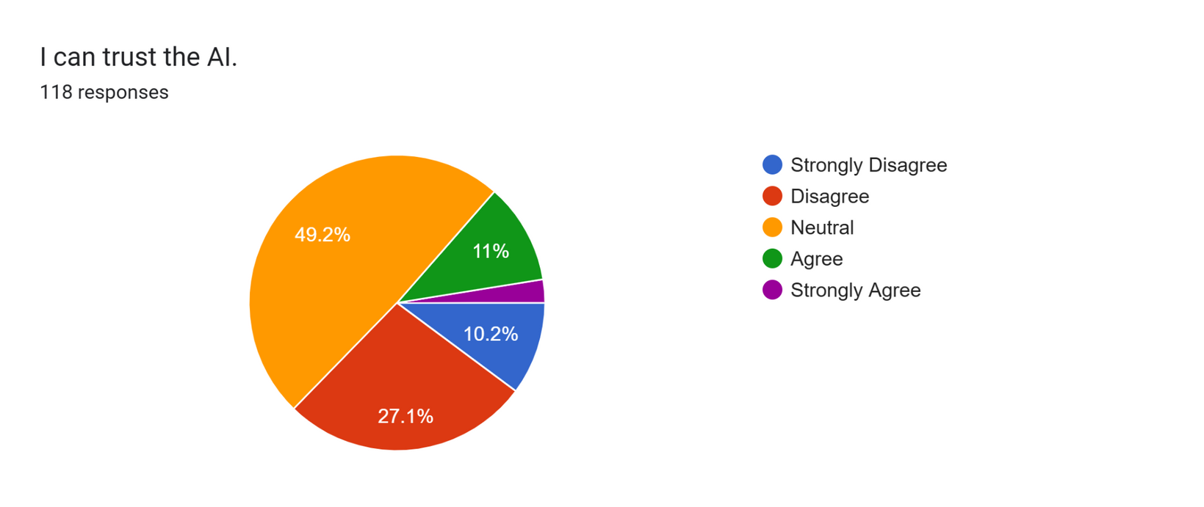
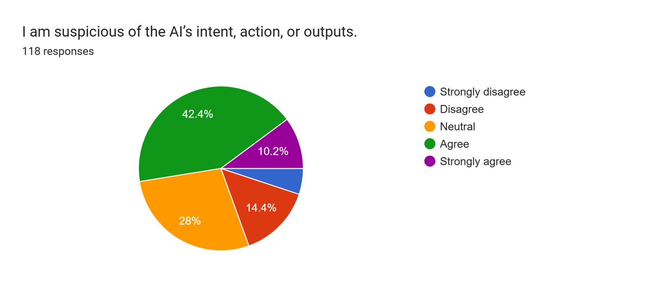
Survey Result Analysis
Most respondents are highly familiar with AI tools
Trust in AI is divided: some are confident, others are skeptical
AI is viewed as helpful for studies and decision-making
Misinformation and loss of critical thinking
Overall impression: cautious but positive toward AI
Recommend AI tools, with advice to use them carefully
Figure: Trust on AI
Figure: Impression on AI’s actions

Slide 6
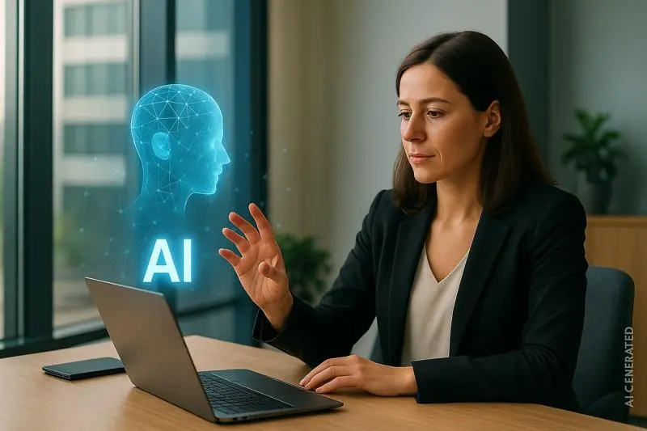
Pattern Analysis 🔍
Trust isn't a single factor: Trust in AI is a complex, multi-faceted concept.
Perceptions of reliability and integrity drive trust: a perception of AI as reliable and having integrity is a strong predictor of higher trust.
Suspicion and perceived harmfulness reduce trust: Suspicion and the belief that AI can be harmful or injurious correlate with lower trust.
Contrasting perceptions: Both confidence and suspicion, suggesting a nuanced relationship.
Image Source : Vlerick

Slide 7

Limitations❗
Small sample size: The sample of 120 university students may not represent the general population.
Convenience sampling: This method could introduce bias.
Self-reported data: Responses may be influenced by social desirability bias.
No long-term study: The research is a one-time survey, lacking insights into how trust in AI might change over time.
Image source: Dreamstime

Slide 8
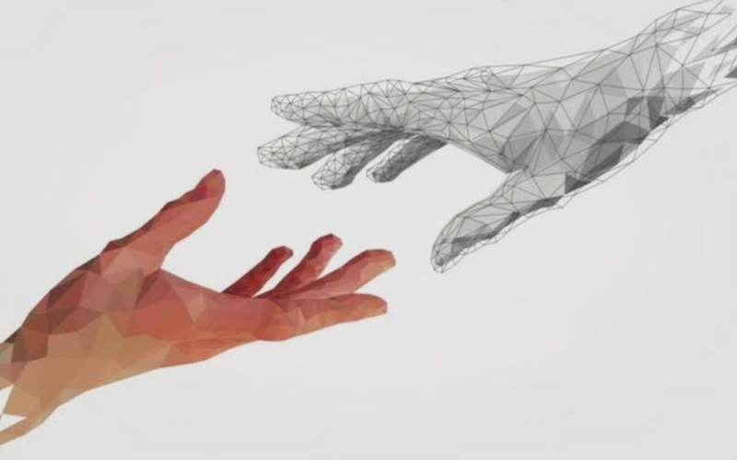
RECOMMENDATIONS
- Conduct education campaign on AI usage
- Creat clear guideline to reduce blind trust
- Raise awareness of AI limitation

Slide 9

CONCLUSION
-Blind trust in AI can be risky
-
Awareness of limitations ensure
responsible use

Slide 10
Thank you!

